Slide 1

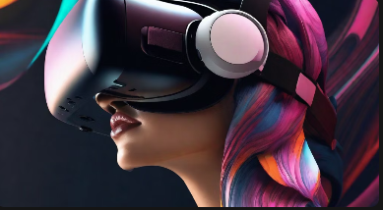
The Intersection of Art and Technology

Slide 2
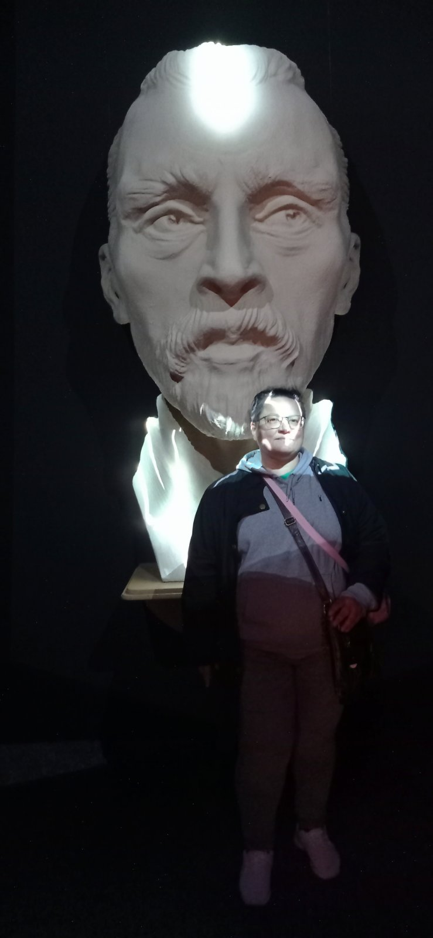
Introduction to Digital Technologies in Fine Art Exhibitions
In recent years, the use of digital technologies in fine art exhibitions has become increasingly common. From interactive installations to virtual reality experiences, these technologies offer new ways for audiences to engage with and experience art

Slide 3
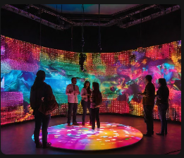
Digital Art Installations
Digital art installations have become increasingly popular in art exhibitions. These installations use technology such as projectors, screens, and interactive displays to create unique and immersive experiences for viewers.
Digital art installations can also incorporate sound and lighting effects to enhance the overall experience.

Slide 4
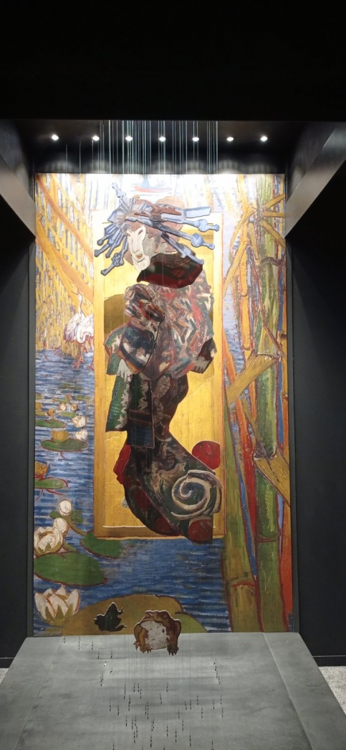
Virtual Reality Exhibitions
Benefits of VR Exhibitions Increased engagement and interaction with art. Ability to view artwork from different angles and perspectives. Opportunity to experience art in a new and immersive way.
Examples of VR
Exhibitions
Many art museums and galleries around the world have begun incorporating VR technology into their exhibitions.

Slide 5
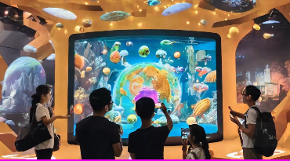
Interactive Exhibits
Benefits of Interactive Exhibits
Interactive exhibits provide a unique and memorable experience for visitors, making them more likely to remember and talk about the art they saw. They also allow for a deeper understanding and appreciation of the art, as visitors can actively engage with it and explore its history and context.
Examples of Interactive
Exhibits
Some examples of interactive exhibits include touch screen displays that allow visitors to explore the history and context of a particular artwork, virtual reality experiences that transport visitors to a different time and place, and digital art installations that respond to visitors' movements and actions.

Slide 6
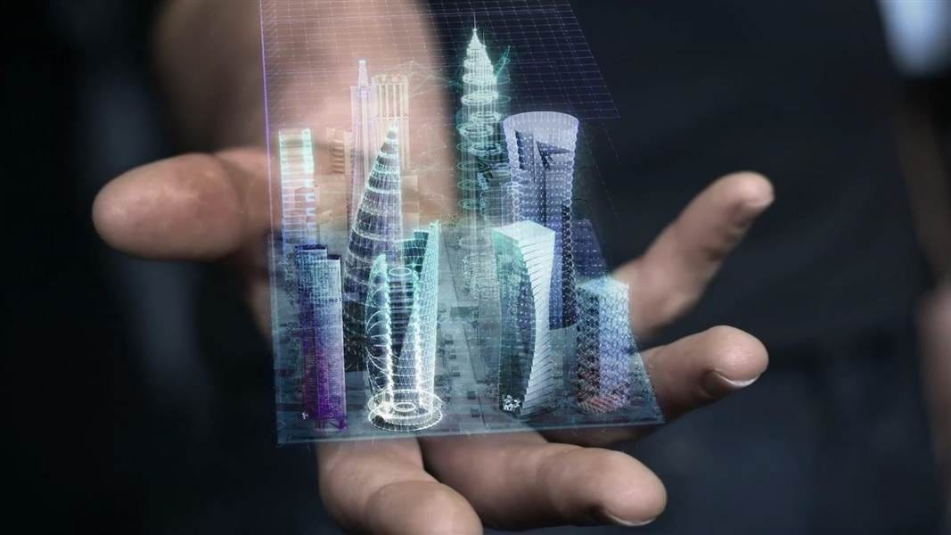
Augmented Reality in Art Exhibitions
Augmented reality (AR) is a digital technology that superimposes computer-generated images onto a user's view of the real world.

Slide 7
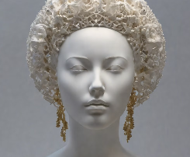
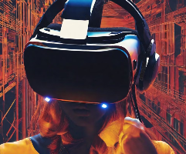
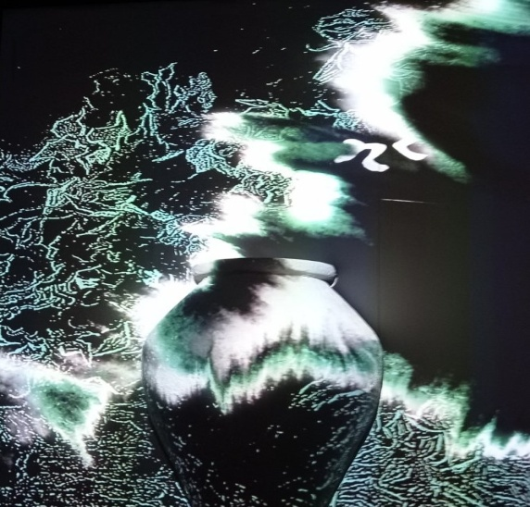
Digital Art Curation
3D Printing
3D printing technology has revolutionized the way that fine art is created and displayed. Digital sculptures can be designed using computer software and then printed using a 3D printer. These sculptures can then be displayed in exhibitions alongside traditional artwork, blurring the line between digital and physical art.
Virtual Reality
Virtual reality technology allows for the creation of fully immersive digital art experiences. By wearing a VR headset, viewers can interact with digital art in ways that were previously impossible, such as walking through a digital sculpture or exploring a virtual environment.
Projection
Projection mapping is a technique that uses video projectors to display digital images onto three-dimensional objects. It is a popular method of displaying digital art in exhibitions as it allows for immersive and interactive experiences.

Slide 8

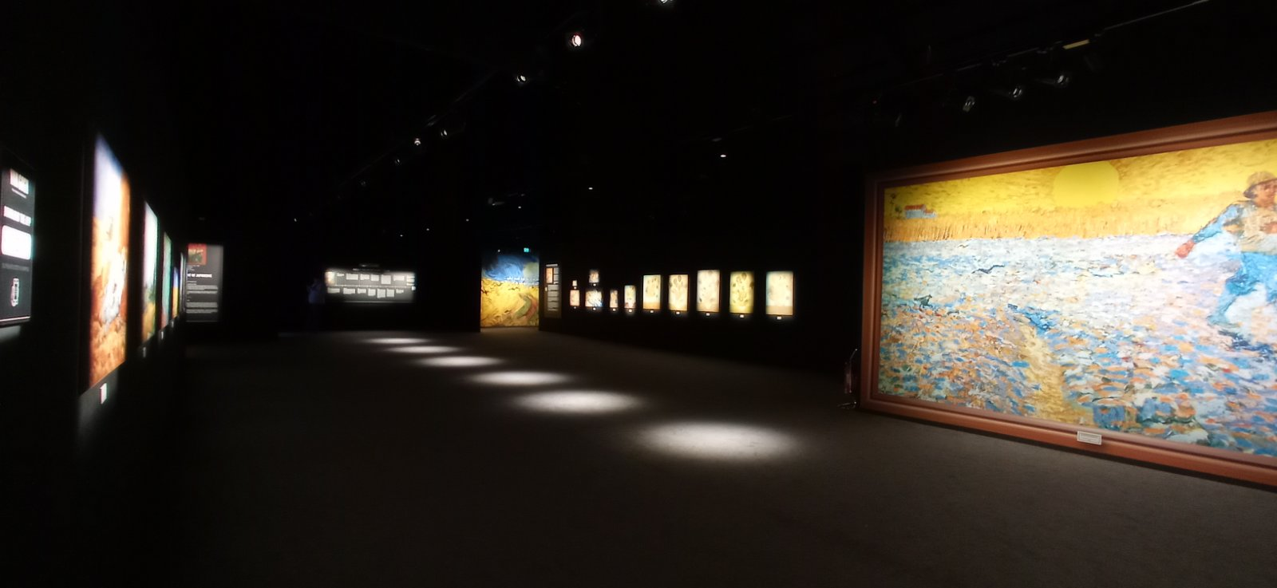
Benefits and Challenges of Digital Technologies in Art Exhibitions
Benefits
Increased engagement and interactivity with the artwork. Ability to showcase digital artworks that cannot be displayed traditionally. Enhanced accessibility for audiences with disabilities. Opportunity to reach a wider audience through online exhibitions.
Challenges
Costs associated with implementing and maintaining digital technologies.
Technical difficulties and potential for equipment failure during exhibitions. Concerns over the preservation and authenticity of digital artworks. Potential for over-reliance on technology, detracting from the artwork itself.

Slide 9
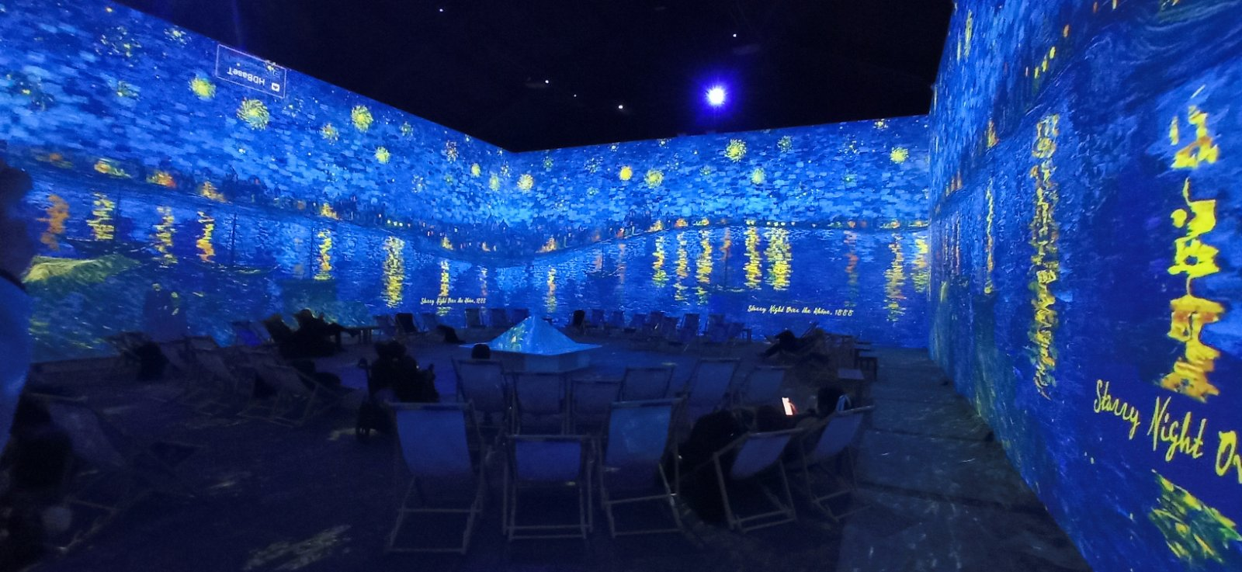
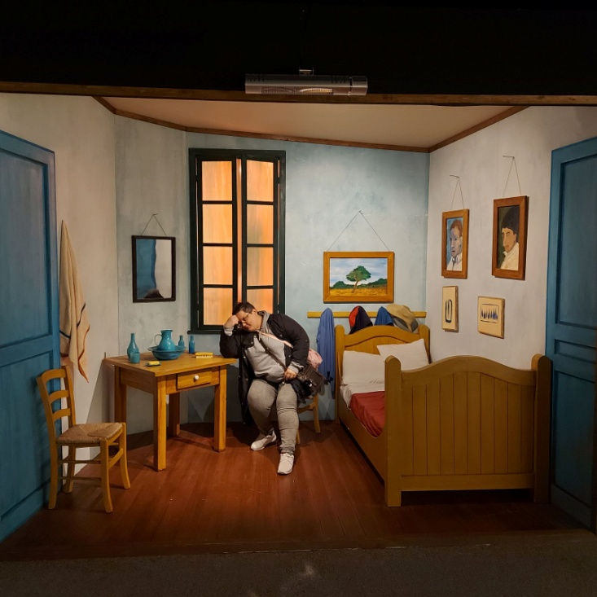
Case Studies
A huge room was created at the Van Gogh exhibition in Dublin. On the walls were broadcast paintings of the artist flowing smoothly one into another. All this was accompanied by music and a story about the artist's life, quotes from his letters to family and friends and statements in public. In the center of the huge room there were armchairs with blankets, on which visitors settled down.
There were also rooms that repeated the content of the paintings. One could enter the room and find oneself "in the painting".

Slide 10
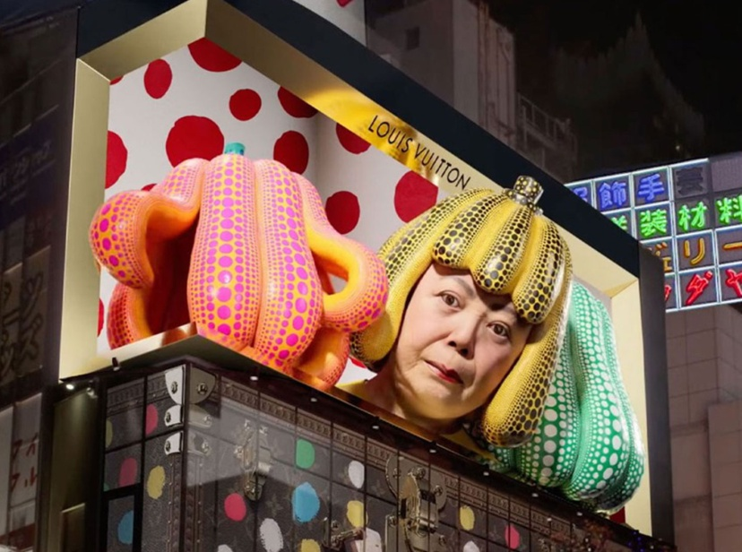
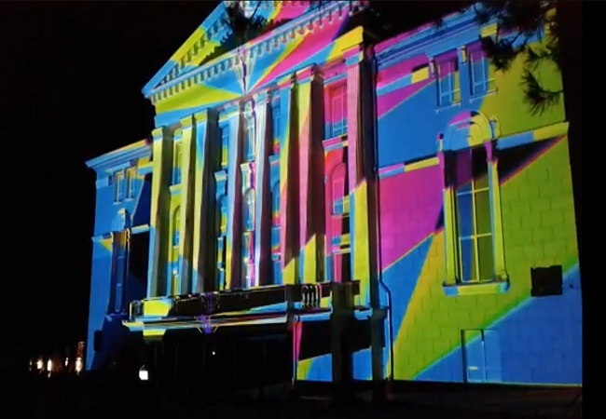
Future of Digital Technologies in Art Exhibitions
Virtual Reality Exhibitions
Interactive Installations
Projection Mapping

Slide 11

Questions?????

Slide 12
Thank you!

